Slide 1
Flip
Helena Gray And Macy Werner

Slide 2
Empathize
Who is the user?
Middle school to College students

Slide 3
Define
How is our app going to help/assist/support
Through learning
Having an organized place for all notecards
Less paper use

Slide 4
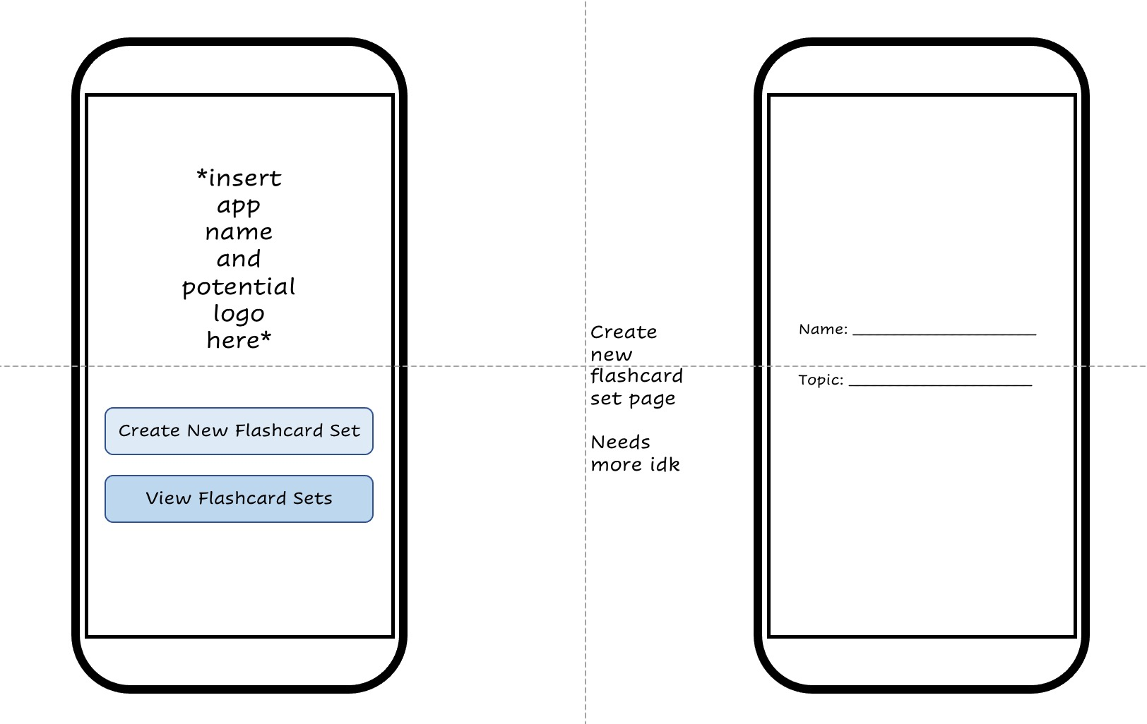
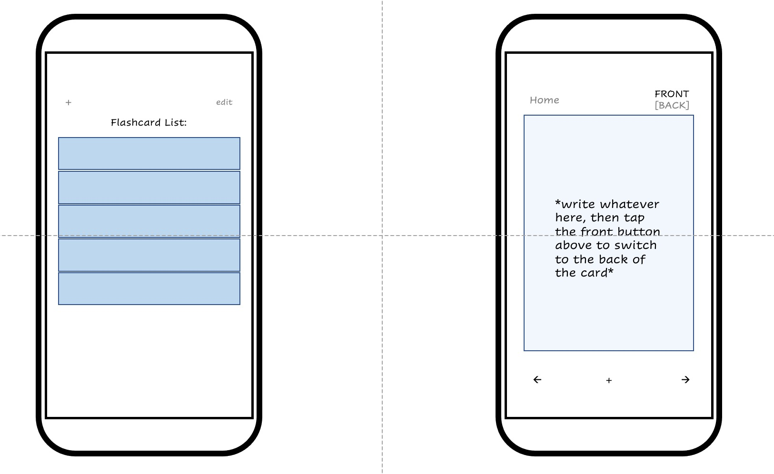
Ideate

Slide 5
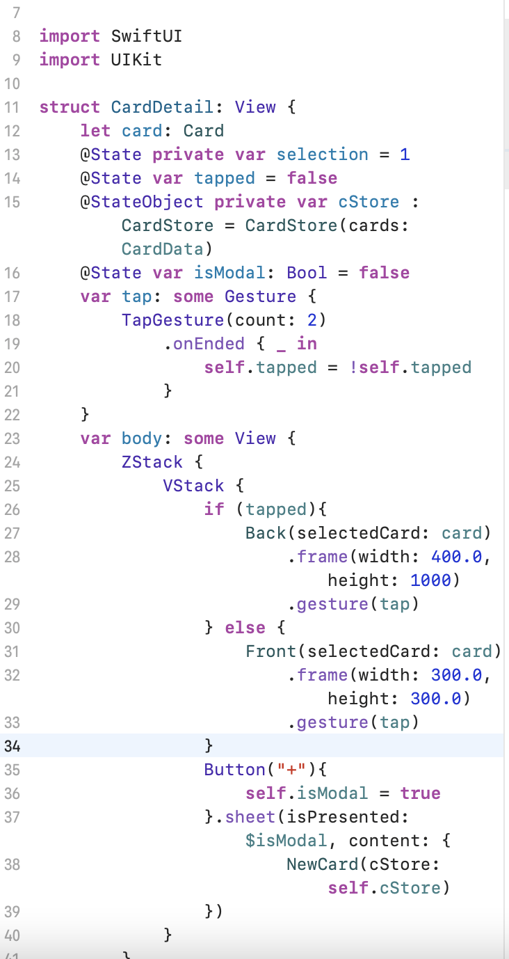
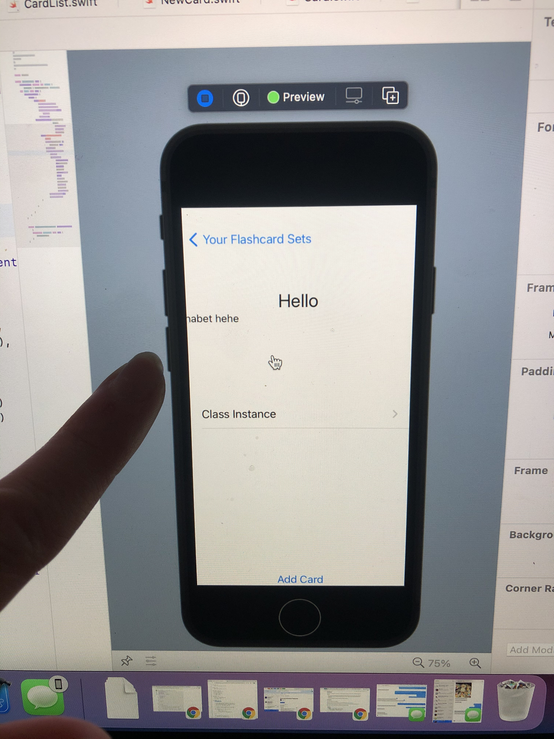
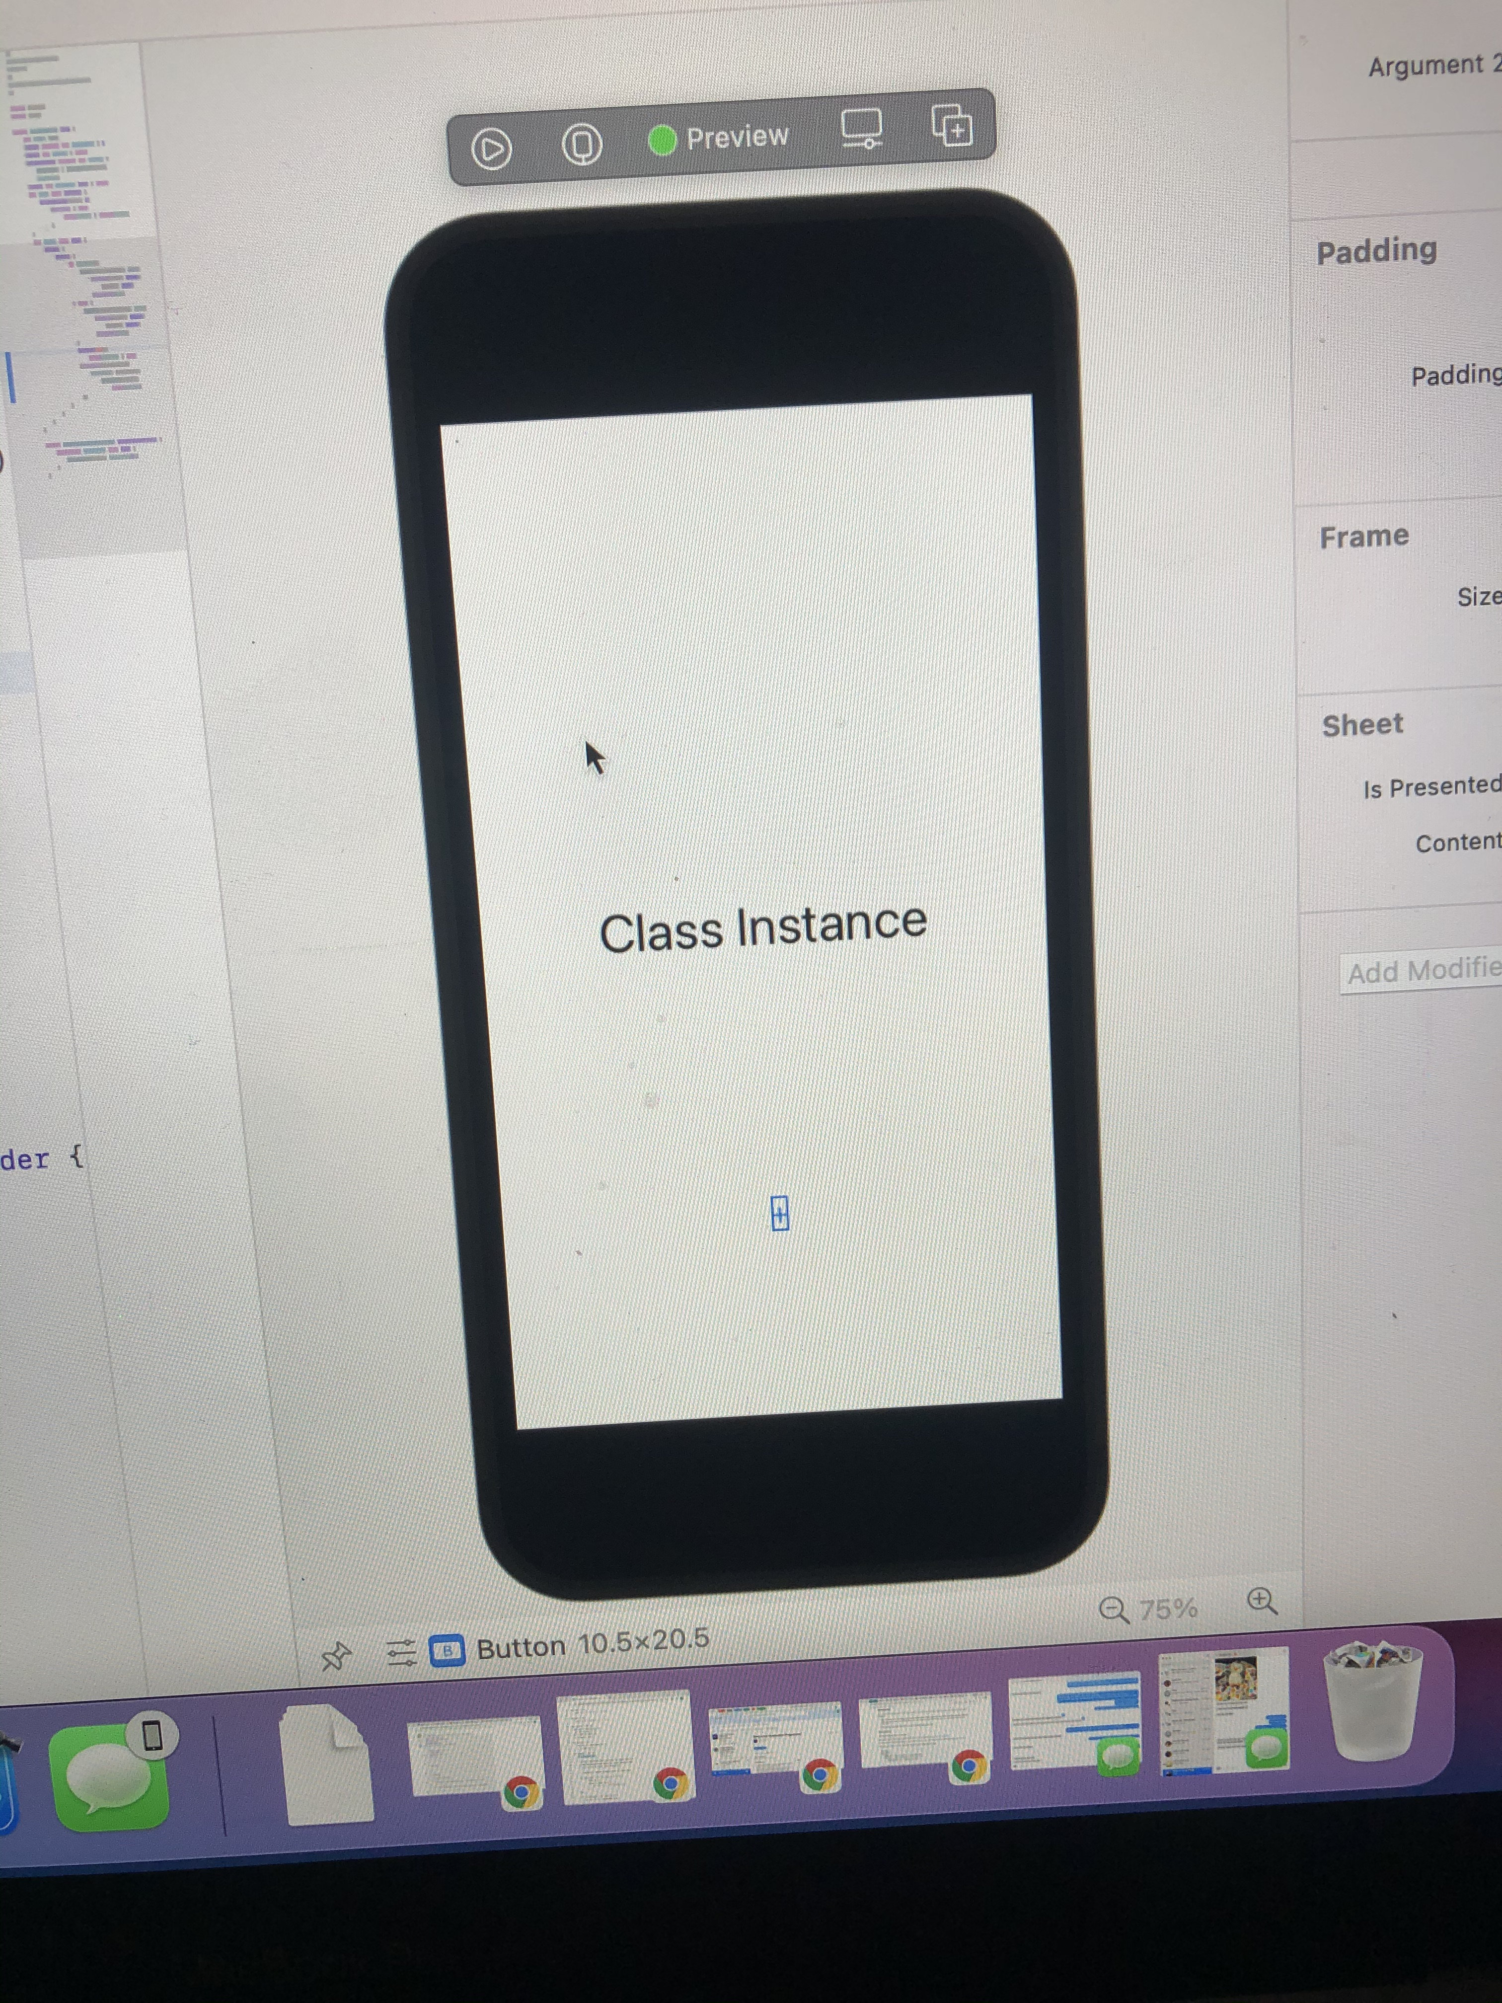
Prototype

Slide 6
Design heuristics
Visibility of system status
Match between system and the real world
User control and freedom
Recognition rather than recall
Aesthetic and minimalist design
Aesthetic Integrity
Feedback
Consistency
User Control

Slide 7
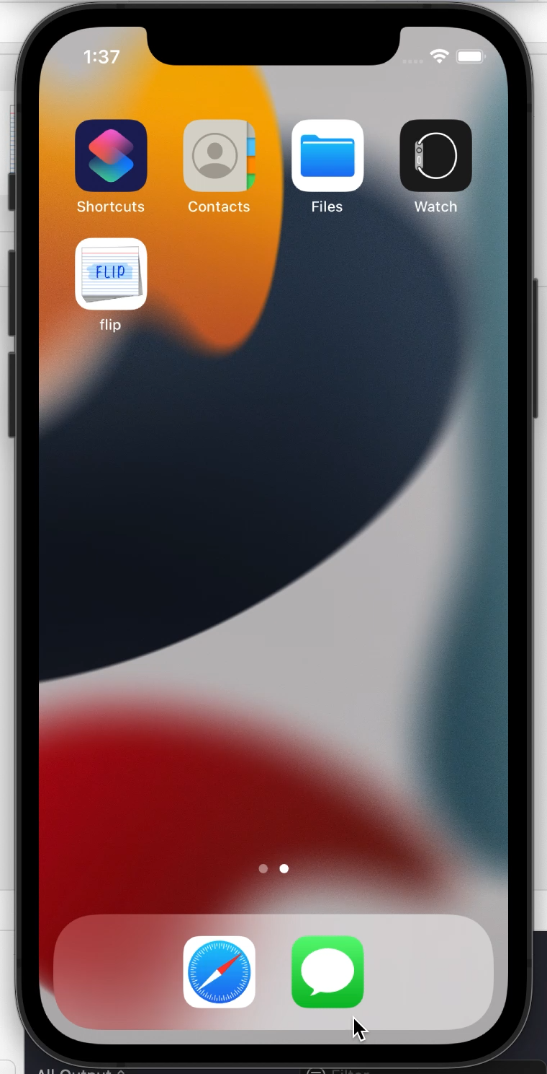
Video Demo

Slide 8
Conclusion
What we learned?
What’s next for Flip?

